Slide 1

SANJIVANI UNIVERSITY
Project Name :
Safety And Security In School Or Institute .
NAME OF STUDENTS :
  1.Vedant Borawake
  2.Narendra Shelke
  3.Siddhesh Jadhav
  4. Tejas Satpute
  5. Pritam Wable
  6. Sai Mahandhule
  UNDER THE GUIDANCE OF :
  Dr. Ajit Mujumdar
  Prof. Pravin Chokakkar
Department of Computer Science and Engineering,
Sanjivani University,
Rural Education Society, Kopargaon,Maharashtra.

Slide 2
What is Design thinking and ideal lab ?
“ Design Thinking ”is a problem-solving approach that focuses on understanding users,
challenging assumptions, and redefining problems to identify alternative strategies and solutions.
It typically involves five stages
1 .Emphatize
2. Define
3. Ideate
4. Prototype
5. Test
Group number : 15
Group Members :
1.Narendra Shelke 2124UCEM1028
2.Vedant Borawake 2124UCEM112
3. Siddhesh Jadhav 2124UCEM100
4. Pritam wable 2124UCEM
5.Tejas Satpute 2124UCEM1022
Department of Computer Science and Engineering,
Sanjivani University,
Rural Education Society, Kopargaon,Maharashtra.

Slide 3
Topic Selection
Choosing to focus on safety and security in schools or institutions is crucial due to its profound
impact on students’ well-being and the overall learning environment .
Here’s a structured approach to why it’s an
important topic, including drawbacks,current issues, and potential benefits :
Why Choose Safety and Security in Schools?
Student Well-being : Ensuring a safe environment is fundamental for students' physical health.
It helps reduce anxiety and fear, allowing students to focus better on their studies.
Effective Learning Environment*: A secure environment fosters a conducive learning atmosphere.
When student
feel safe, they are more likely to engage in their studies and participate in school activities.
Department of Computer Science and Engineering,
Sanjivani University,
Rural Education Society, Kopargaon,Maharashtra.

Slide 4
Drawbacks of Focusing on Safety and Security
1. *Cost*: Implementing comprehensive security measures can be expensive. This includes investing in security personnel, surveillance systems, and safety infrastructure.2. *Privacy Concerns*: Enhanced security measures, such as surveillance cameras and monitoring systems, can raise concerns about student privacy and the potential for misuse of data.3. *Potential Overreach*: Excessive focus on security might lead to an environment where students feel like they are under constant surveillance, which could impact their freedom and autonomy.
.
Current Issues in School Safety and Security
1. School Shootings and Violence : In some regions, schools face the threat of violence, including shootings, which underscores the need for effective security protocols.
2. Bullying and Harassment: Despite existing measures, bullying and harassment remain prevalent issues in school
. Ensuring effective reporting and response systems is crucial.
3. Cybersecurity Threats : With increasing use of digital tools in education, schools face cybersecurity threats that can compromise student data and disrupt learning
Department of Computer Science and Engineering,
Sanjivani University,
Rural Education Society, Kopargaon,Maharashtra.

Slide 5
Drawbacks of Focusing on Safety and Security
1.Cost : Implementing comprehensive security measures can be expensive.
2. Privacy Concerns : Enhanced security measures, such as surveillance cameras
and monitoring systems,can raise concerns about student privacy and the potential for misuse of data.
How Safety and Security Measures Help :
1.Risk Reduction : Effective safety measures help reduce the of incidents and provide a rapid response
to emergencies when they occur.
2. Enhanced Learning Environment : A secure and safe environment promotes better learning and
engagement by minimizing distractions and fear.
3.Community Trust : Strong safety protocols build trust among students, parents,
and staff, fostering a supportive and collaborative school community.
Department of Computer Science and Engineering,
Sanjivani University,
Rural Education Society, Kopargaon,Maharashtra

Slide 6
                Topic visualization
Definition : Safety refers to the protection of students, staff, and visitors from physical harm,
accidents, and emergencies within the school environment. This includes preventing and responding to
incidents such as accidents, fires, and health-related emergencies .
Security involves safeguarding the school environment from intentional threats and risks, such as violence,
unauthorized access, and vandalism. It encompasses measures to protect against intruders, bullying, and
any other forms of deliberate harm.
Common safety and security features in school / institute
1. Security Cameras
2. Access Control System
Types (Key Cards , Biometric System , Electronic Locks )
3. Alarms system
Types (Fire Alarms , Intruder Alarms )
4. safety Training And Awarees Programs
Types (Training session , information distribution )
Safety and Security :
Department of Computer Science and Engineering,
Sanjivani University,
Rural Education Society, Kopargaon,Maharashtra.

Slide 7
Problem Statement :
In many schools and educational institutions, ensuring safety and security is a significant challenge.
Schools face riskssuch as accidents, violence, bullying, and emergencies like fires or natural disasters.
Current safety measures may not always be effective or comprehensive, leading to concerns about
the well-being of students, staff, and visitors .
Improving safety and security involves addressing these risks, implementing
effective protocols, and ensuring thateveryone in the school knows how to respond in an emergency.
Department of Computer Science and Engineering,
Sanjivani University,
Rural Education Society, Kopargaon,Maharashtra.

Slide 8
Brainstorming
How to design and Innovation ?
Thinking.
Critical thinking.
1.Controll Access.
2.Survelilance.
3.Emergency Management.
Drills.
Staff Training .
Student Awareness.
Department of Computer Science and Engineering,
Sanjivani University,
Rural Education Society, Kopargaon,Maharashtra.

Slide 9
Persona :
Background: Motivation:
Harassment . Positive environment.
violence. Ensure physical safety.
Safety management. Cyber crimes.
Challenges faced:
Lack of management. Doubts/Fears:
Security issue. Fights
Communication System. Drugs
Lack of traning
Aspirations:
Secure Atmosphere
Non-violence
Cyber security
SUMMARY: Now a days many crime are happening in school to stop those crime we have to implement a some security measure.
Department of Computer Science and Engineering,
Sanjivani University,
Rural Education Society, Kopargaon,Maharashtra.

Slide 10
End users :
Sudents
Parents
Staff
School Management
Department of Computer Science and Engineering,
Sanjivani University,
Rural Education Society, Kopargaon,Maharashtra.

Slide 11
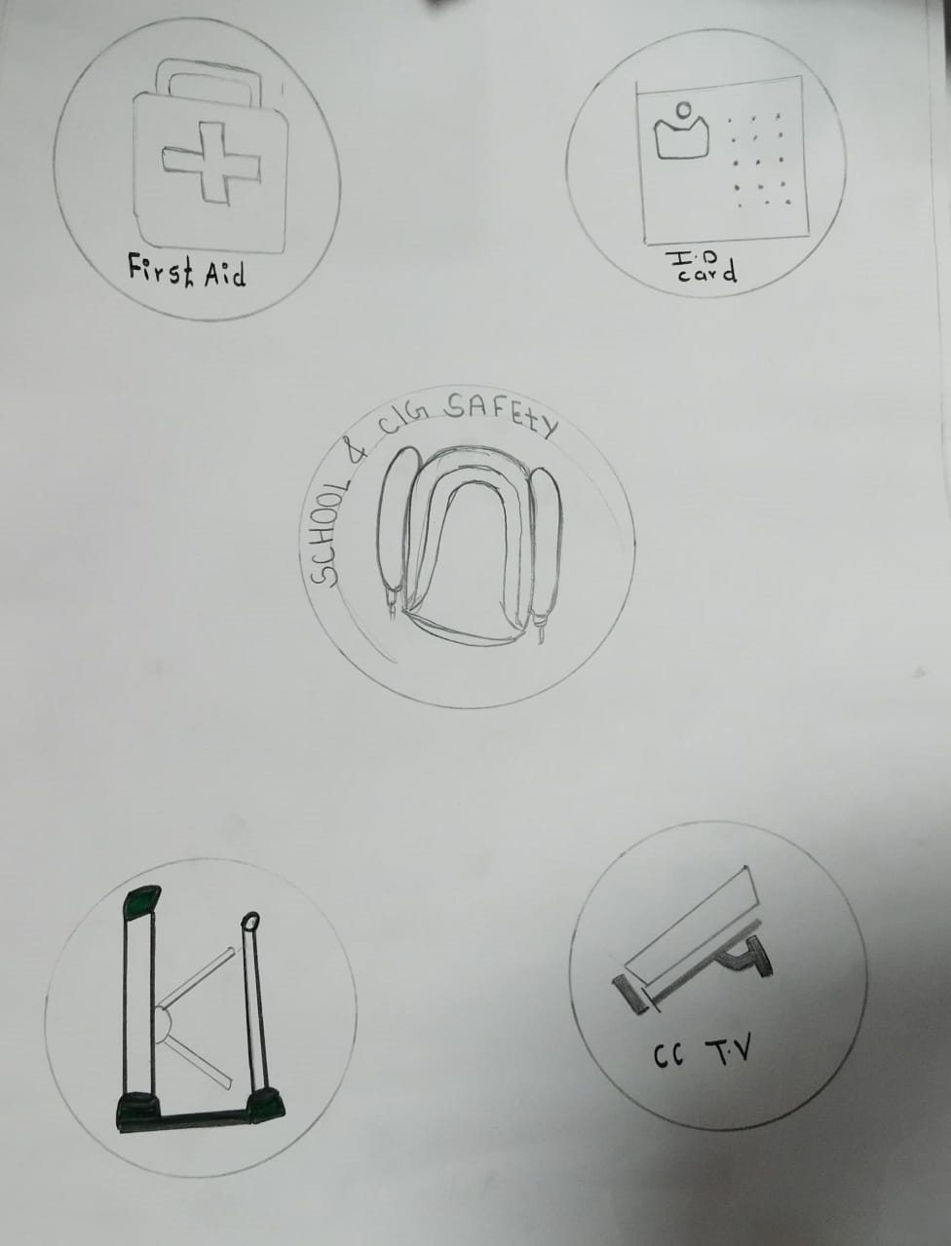
Diagram:
Department of Computer Science and Engineering,
Sanjivani University,
Rural Education Society, Kopargaon,Maharashtra.

Slide 12
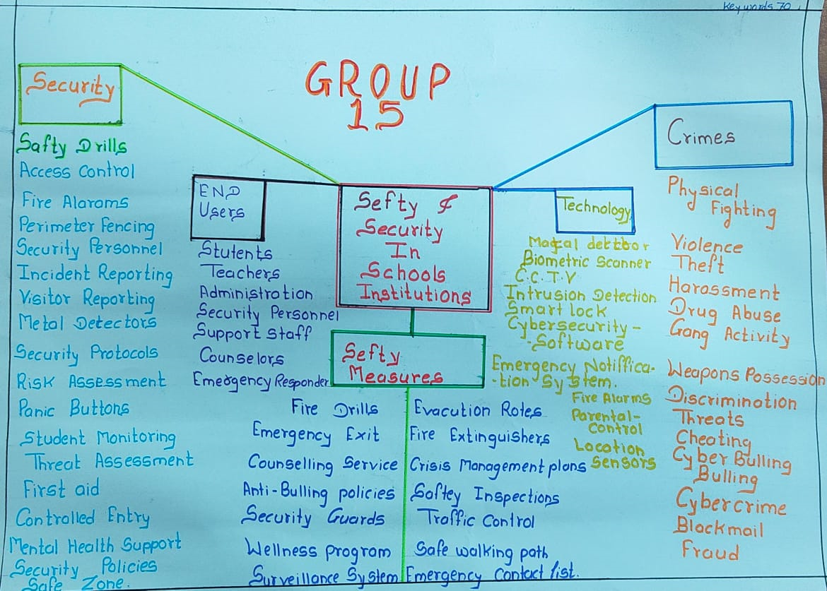
Mind mapping:
Department of Computer Science and Engineering,
Sanjivani University,
Rural Education Society, Kopargaon,Maharashtra.

Slide 13

5w and 1H
Prepare a 30 question on
on our project which help us to
clear our ideas.
Department of Computer Science and Engineering,
Sanjivani University,
Rural Education Society, Kopargaon,Maharashtra.

Slide 14
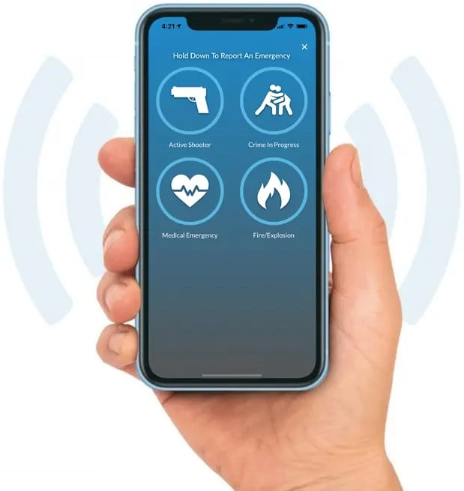
Future Scope:
Mobile app
Biometric Scanner
Department of Computer Science and Engineering,
Sanjivani University,
Rural Education Society, Kopargaon,Maharashtra.

Slide 15


Content :
1.Problem Statement
2.Theory of Priotorization
3.Scamper Activity
4.Prototype APP or 3D model
5.Journey Map
Department of Computer Science and Engineering,
Sanjivani University,
Rural Education Society, Kopargaon,Maharashtra.

Slide 16
Theory of Prioritization :
Problem Statement :
The issue of safety and security have become big problem in school and institutions to overcome this problem we are developing an emergency response system.
Department of Computer Science and Engineering,
Sanjivani University,
Rural Education Society, Kopargaon,Maharashtra.

Slide 17
Theory Of Priotorization :
1. Emergency Response delays1111 | 4200
2. Lack of advanced technology | 3300
3. Lack of awareness of safety and security | 2400
4. Financial problem | 1410
5. Unautorized access | 1320
6. Cyber security threads | 1000
7. No parents involvement | 510
8. Impact of Investment | 410
Department of Computer Science and Engineering,
Sanjivani University,
Rural Education Society, Kopargaon,Maharashtra.

Slide 18
Scamper Tool
S
Substitute
C
Rearrange or Reverse
R
Combine
Scamper
A
Adapt
E
Eliminate
M
Modify
Put to another use
P
Department of Computer Science and Engineering,
Sanjivani University,
Rural Education Society, Kopargaon,Maharashtra.

Slide 19
Scamper tool used :
1. Combine :
Combine school emergency protocols with local emergency services for joint training and communication
Department of Computer Science and Engineering,
Sanjivani University,
Rural Education Society, Kopargaon,Maharashtra.

Slide 20
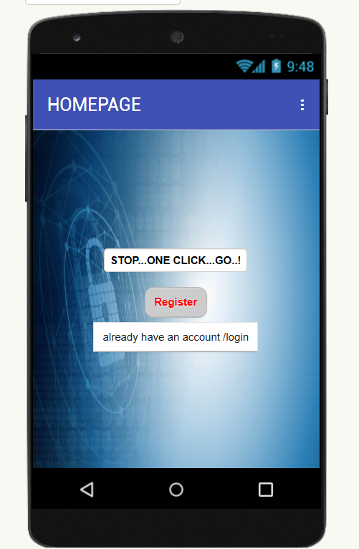
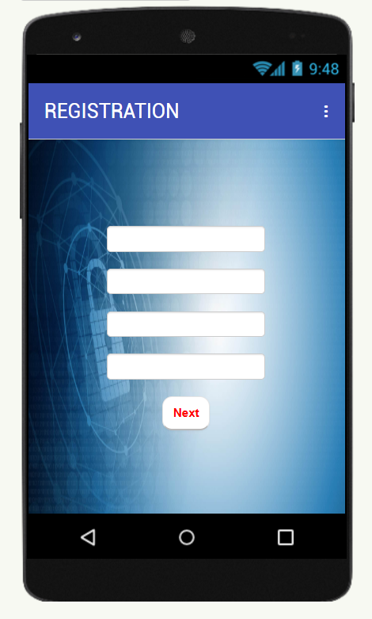
Prototype
Department of Computer Science and Engineering,
Sanjivani University,
Rural Education Society, Kopargaon,Maharashtra.

Slide 21
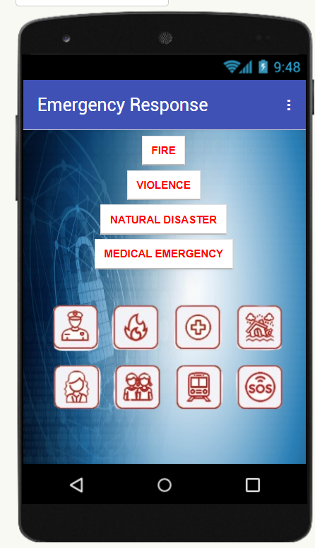
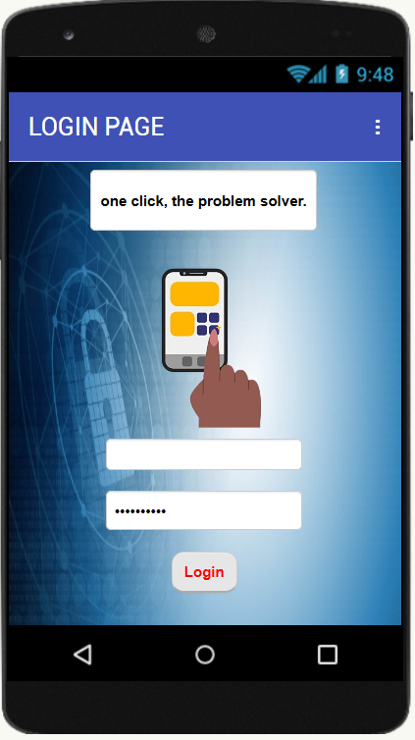
Prototype
Department of Computer Science and Engineering,
Sanjivani University,
Rural Education Society, Kopargaon,Maharashtra.

Slide 22
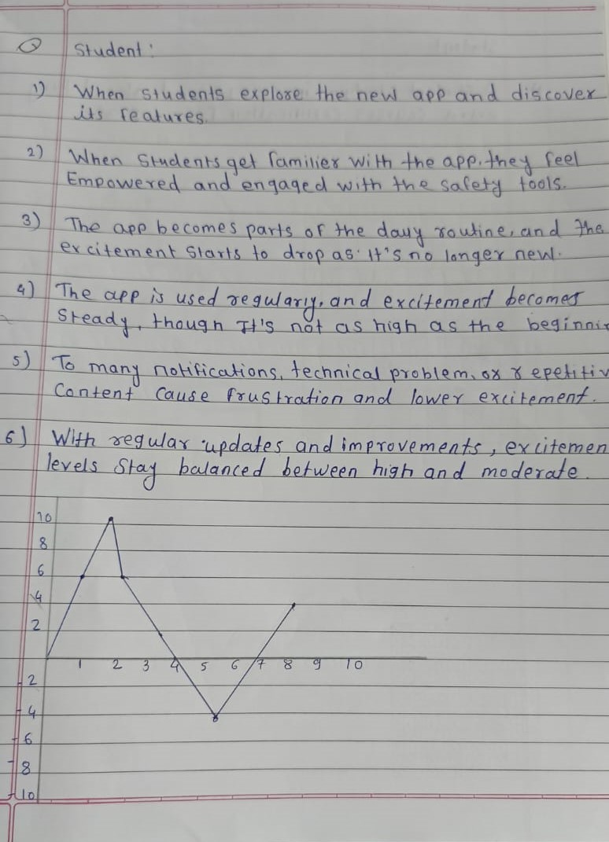
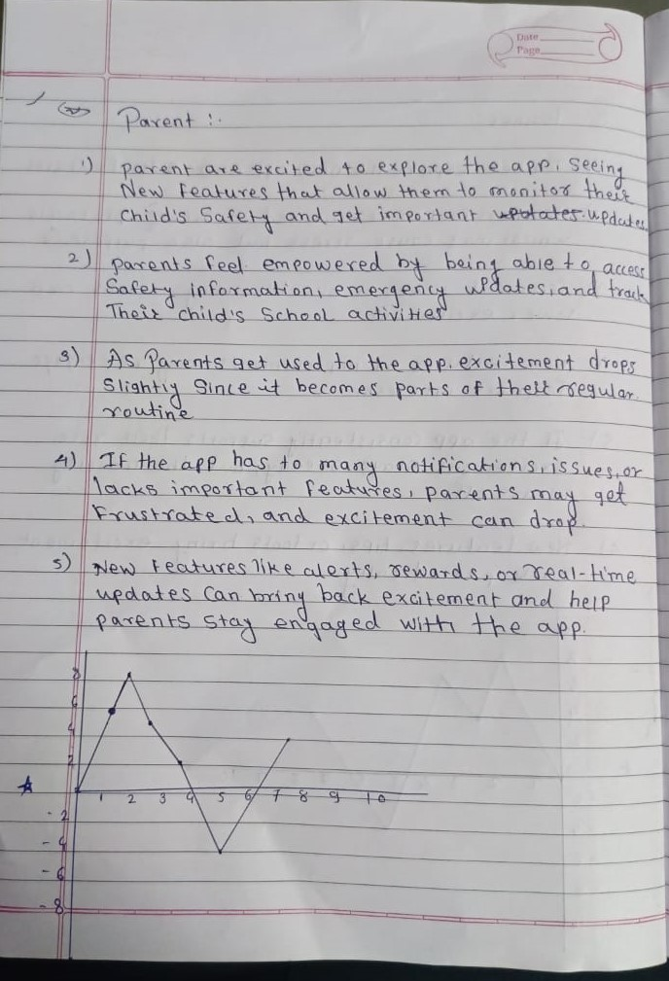
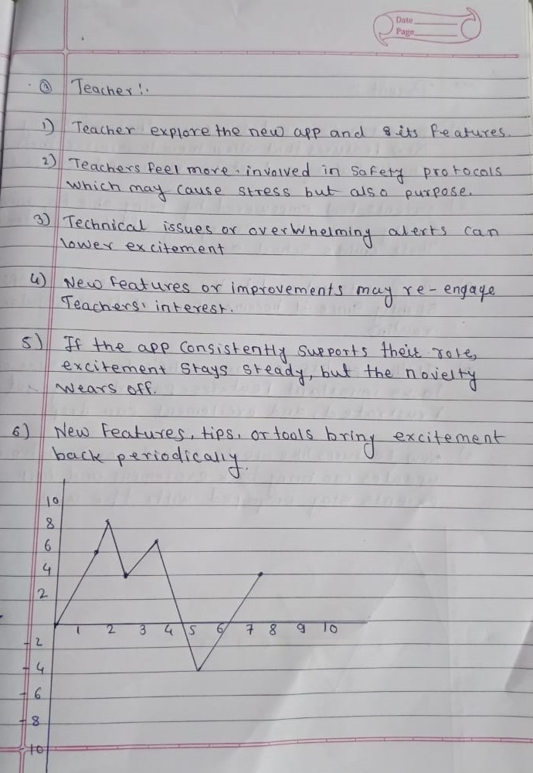
Journey Map
Department of Computer Science and Engineering,
Sanjivani University,
Rural Education Society, Kopargaon,Maharashtra.

Slide 23

Thank You…!
Department of Computer Science and Engineering,
Sanjivani University,
Rural Education Society, Kopargaon,Maharashtra.

